Slide 1
Mining 2020
Industry Overview

Slide 2
Overview

Slide 3
If you have turned on a light, entered a building, driven on a road, made a phone call, used a computer or visited a doctor, then mining is an important part of your life.

Slide 4
Mining at
a Glance
537,000
Number of direct mining industry jobs.¹
1,026,000
Number of indirect jobs generated by the mining industry.¹
$80,000+
Average annual salary for
a miner, well above the U.S. average wage of $57,000.²
40,000 lbs.
Average weight of newly
mined materials used by every American each year, including two tons of coal.³
$111B
Annual U.S. revenues generated through mining.¹
Notes:
¹ Source: Based on Mine Safety & Health Administration (MSHA) 2019 employment data and 2012 IMPLAN economic multipliers.
² Bureau of Labor Statistics, http://www.bls.gov/cew/
³ Mineral Information Institute, http://mineralseducationcoalition.org/mining-minerals-information/mining-mineral-statistics/

Slide 5
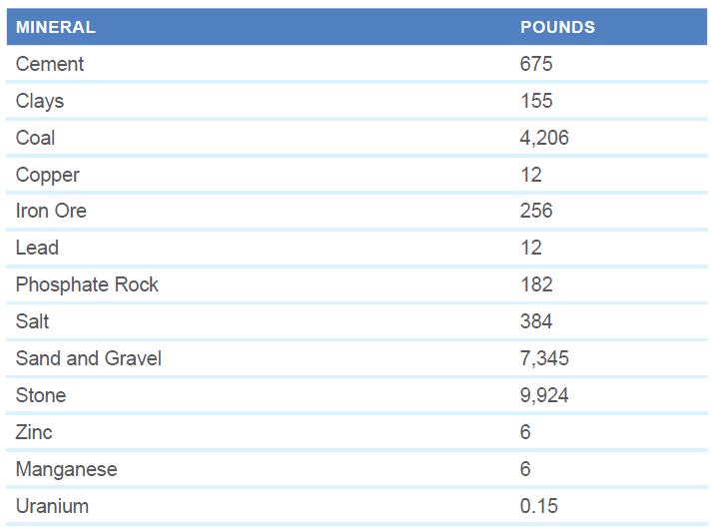
U.S. Per Capita Consumption of Minerals and Coal, 2018
NMA calculations based on preliminary
USGS, EIA and U.S. Census Bureau data
The National Mining Association | Mining 2020 Industry Overview | 5

Slide 6
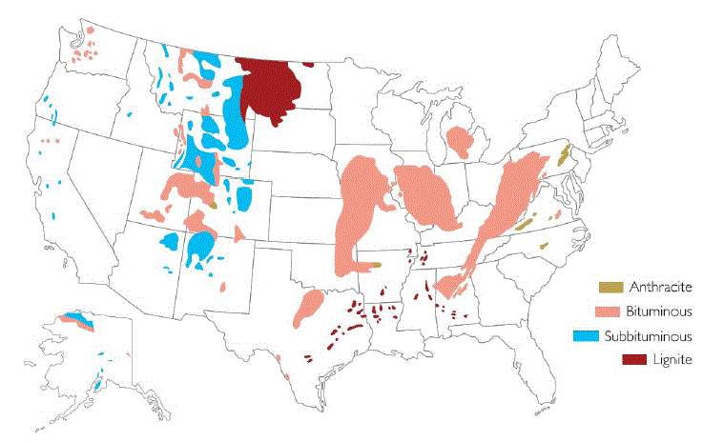
Coal: Reserves in the United States
Total U.S. Coal Reserves – 253 Billion Short Tons (2018)
Sources: NMA; EIA; ACF
The National Mining Association | Mining 2020 Industry Overview | 6

Slide 7
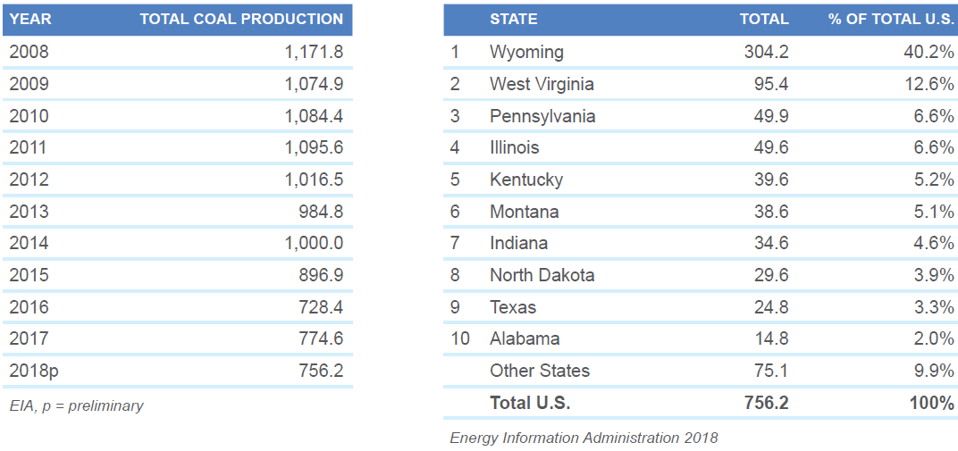
Coal: U.S. Production (million short tons)
The National Mining Association | Mining 2020 Industry Overview | 7

Slide 8
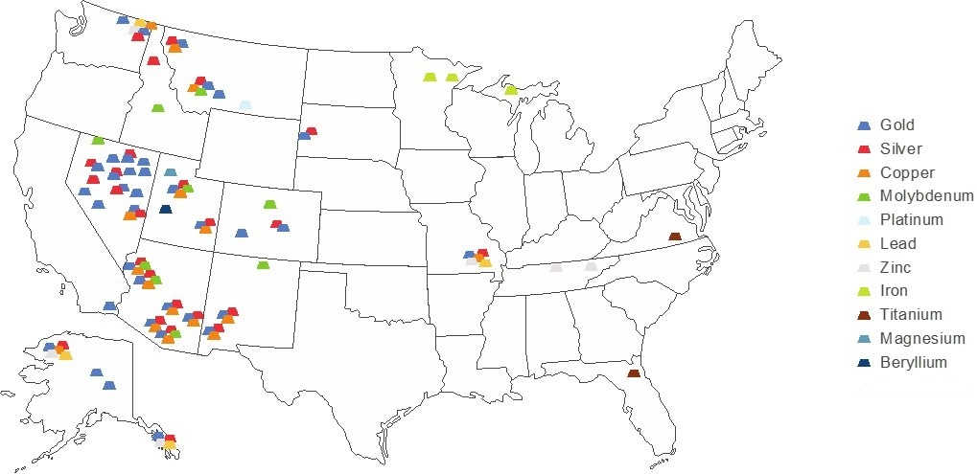
Minerals: Major Metal Producing Areas
Source: U.S. Geological Survey
The National Mining Association | Mining 2020 Industry Overview | 8

Slide 9
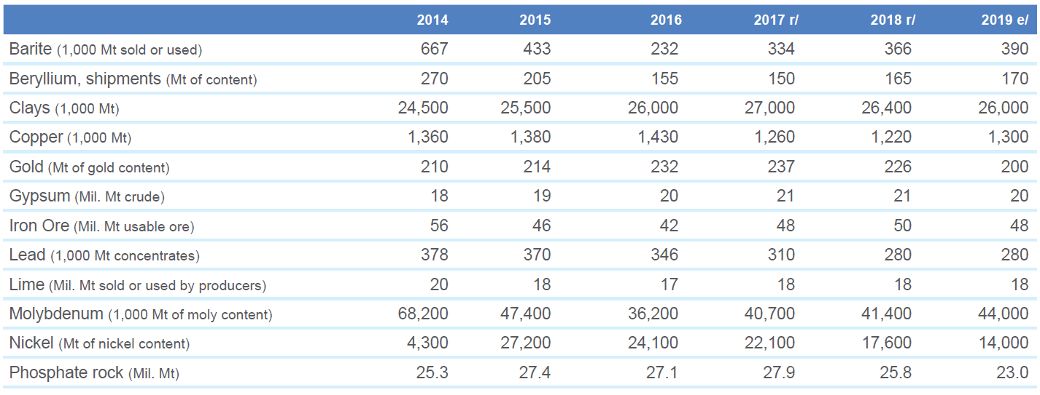
Minerals: Production Statistics of Selected Minerals 2014–2019
The National Mining Association | Mining 2020 Industry Overview | 9

Slide 10
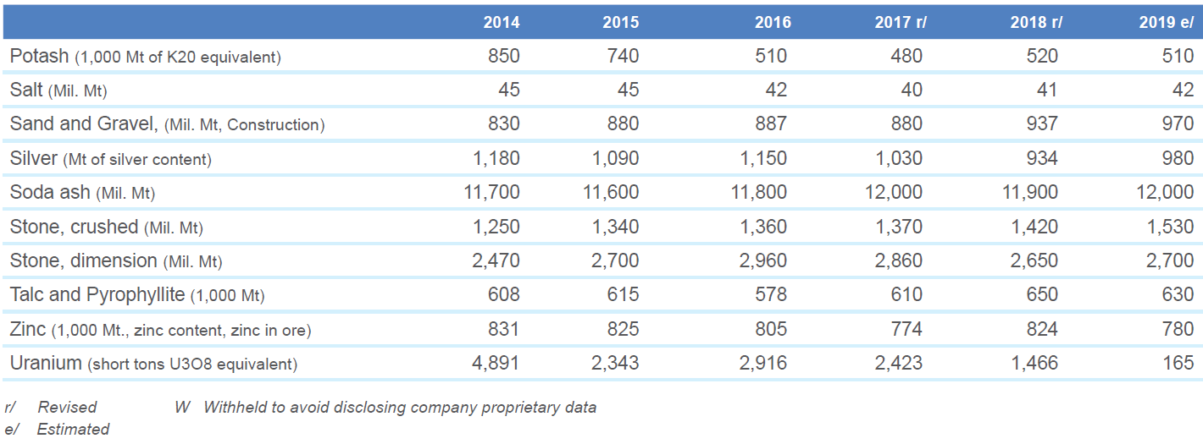
Minerals: Production Statistics of Selected Minerals 2014–2019 (cont’d)
The National Mining Association | Mining 2017 Industry Overview | 10
The National Mining Association | Mining 2020 Industry Overview | 10

Slide 11
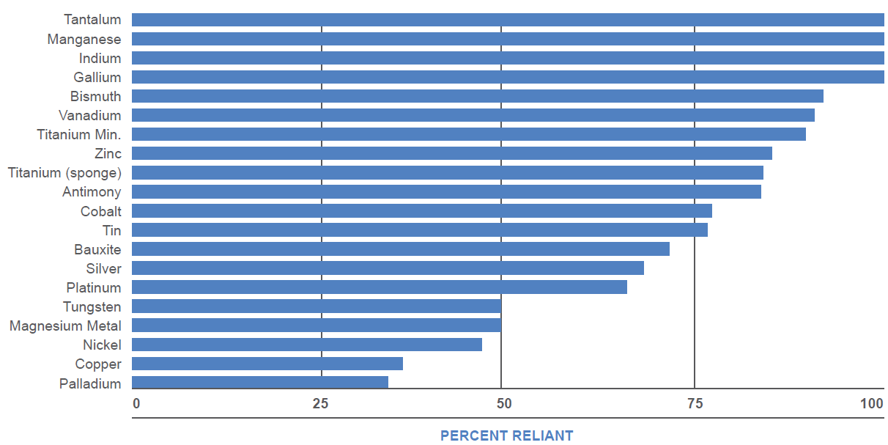
Minerals: U.S. Net Import Reliance
Source: USGS Mineral Commodity Summaries 2020 edition
The National Mining Association | Mining 2020 Industry Overview | 11

Slide 12
A Heavily
Regulated Industry

Slide 13
Major Laws Applicable to Coal and Mineral
Mining Operations
Federal
Surface Mining Control and Reclamation Act
National Environmental Policy Act
Clean Water Act
Clean Air Act
Resource Conservation and Recovery Act
Superfund and Toxics Release Inventory
Endangered Species Act
National Historic Preservation Act
Federal Land Policy Management Act
National Forest Management Act
Antiquities Act
State
State environmental policy acts
State surface water discharge permits
State ground water protection laws or regulations
Storm water permits
Construction permits for dams or impoundments
Air quality permits
Solid waste disposal
Water appropriation permits
Mine operating permits
Reclamation plan approvals or permits
Reclamation bonding
Environmental performance bonding
The National Mining Association | Mining 2020 Industry Overview | 13

Slide 14
Providing the Resources for a Better Life

Slide 15
Mining for Our Future
Innovative technologies made possible through and employed by mining are providing the mineral and energy resources essential for a better life and a better future.
  Advancing innovation. Minerals are supporting innovation everywhere you look, from electric vehicles that depend on their conductivity to medical applications that utilize their antimicrobial capabilities.
  Utilizing innovation. Advanced technologies are making combustion of coal more efficient and cleaner every day. Dramatic reductions of sulfur dioxide, nitrogen oxide and particulate matter that have already been achieved show how advancements in emissions technology, including carbon capture utilization and storage, hold even more promise for the future. And affordable, commercially-available high efficiency, low emissions technologies are capable of cutting U.S. coal-plant emissions by up to 21 percent.
The National Mining Association | Mining 2020 Industry Overview | 15

Slide 16
Spurring Innovation
1,000%
Mining is key to advancing technologies for the future.
66
Number of minerals used
to make the screen, case, chips, circuitry and battery of a computer.³
4.7 tons
Amount of copper needed for a single wind turbine
Projected increase in demand for minerals needed for future energy technologies, according to the World Bank.
.000002 in.
Thickness of gold film that is applied to astronauts’ visors to reduce glare from intense sunlight. Gold is used in hundreds of ways in every space vehicle.²
7%
Amount of global silver demand utilized in the production of solar panels.
20%
Percent of manufactured goods that contain platinum group metals.⁴
Notes:
¹ World Bank, https://www.worldbank.org/en/topic/extractiveindustries/brief/climate-smart-mining-minerals-for-climate-action
² American Museum of Natural History, http://www.amnh.org/exhibitions/gold/incomparable-gold/gold-properties
³ Mine-Engineer.com, http://mine-engineer.com/mining/minerals_Computer2.htm
4 SecureMetals.com, http://www.securemetals.com/metals/platinum/

Slide 17
U.S. Economy
116,000
Number of direct coal mining industry jobs.¹
289,000
Number of indirect coal mining jobs.²
Mining provides essential power and materials for nearly every industry and consumer product, and supplies low-cost, reliable fuel for homes and businesses across the country.
421,000
Number of direct minerals mining industry jobs.¹
737,000
Number of indirect minerals mining jobs.²
$16,000,000,000
Amount of federal, state and local taxes attributable to mining.⁴
Notes:
¹ Based on Mine Safety & Health Administration (MSHA) 2019 preliminary employment data and 2012 IMPLAN economic multipliers, and includes those involved in the transportation of coal and minerals, and support activities.
² Based on Mine Safety & Health Administration (MSHA) 2015 employment data and 2012 IMPLAN economic multipliers.
³ Economic Contributions of Mining, http://nma.org/pdf/fact_sheets/ecm.pdf
⁴ Ibid.
⁵ Ibid.

Slide 18
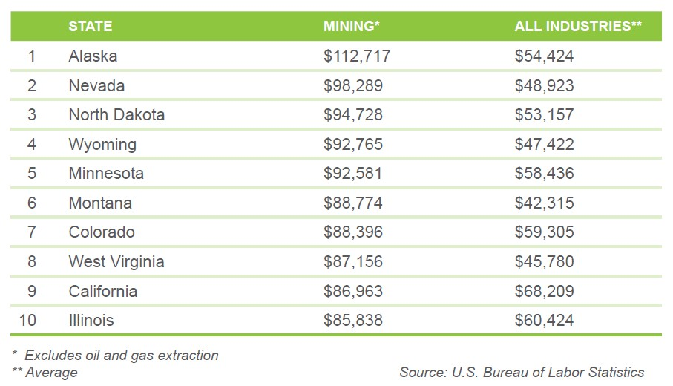
Annual Mining Wages vs. All Industries, 2018
The National Mining Association | Mining 2017 Industry Overview | 18
The National Mining Association | Mining 2020 Industry Overview | 18

Slide 19
Maintaining Energy Security
$93 billion
Amount Americans save in electricity costs annually through a diverse power grid anchored by coal.¹
29
Number of minerals it takes to deliver electricity to our homes and businesses.
Americans expect reliable and affordable energy, powered by a diverse mix of coal, natural gas, nuclear power, oil and renewable sources. Diversification ensures that U.S. households and businesses can minimize market disruptions, making electricity accessible and affordable to all.
28%
Amount of U.S. electricity that comes from coal.²
87%
Amount of U.S. fossil energy reserves (coal, natural gas and oil) that comes from coal on a BTU basis.⁴
19%
Amount of electricity generated from nuclear energy powered by uranium.³
24%
Portion of total world coal reserves held by the U.S., the most of any country.⁵
Notes:
¹ IHS report, “The Value of US Power Supply Diversity," https://energycommerce.house.gov/news-center/blog-posts/new-study-calculates-benefits-electricity-diversity
² Energy Information Administration, http://www.eia.gov/totalenergy/data/monthly/; http://www.eia.gov/coal/annual/
³ Energy Information Administration, https://www.eia.gov/tools/faqs/faq.cfm?id=427&t=3
⁴ Energy Information Administration, http://www.eia.gov/totalenergy/data/monthly/; http://www.eia.gov/coal/annual/
⁵ BP Statistical Review of World Energy June 2019, http://www.bp.com/en/global/corporate/energy-economics/statistical-review-of-world-energy.html

Slide 20
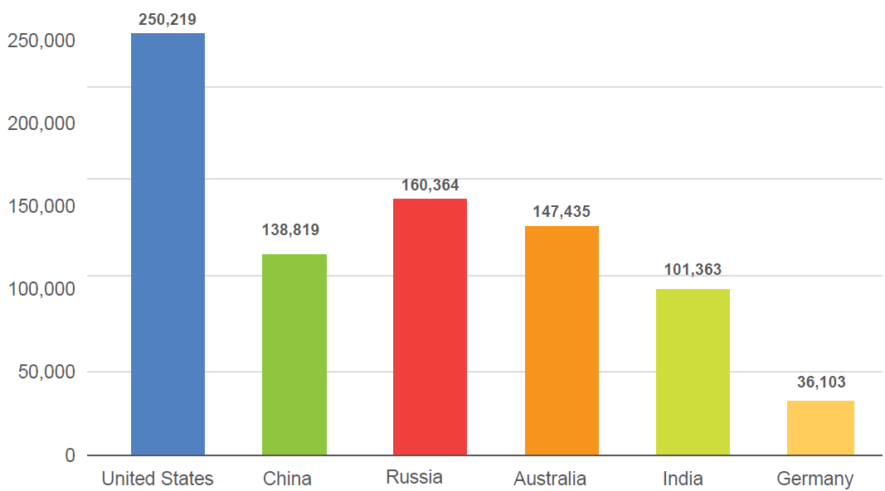
Coal: World Recoverable Reserves, 2018
(million metric tons)
Source: BP Statistical
Review of World Energy
The National Mining Association | Mining 2020 Industry Overview | 20

Slide 21
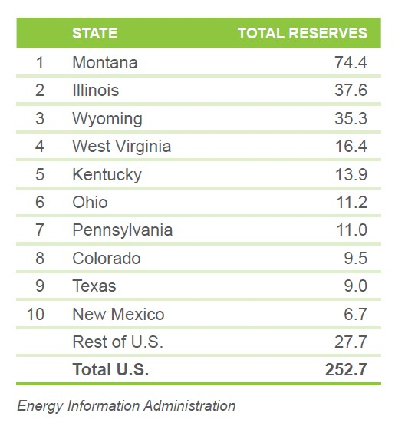
Coal: U.S. Recoverable Reserve Base, 2018
Top 10 States (billion short tons)
The National Mining Association | Mining 2020 Industry Overview | 21
The National Mining Association | Mining 2017 Industry Overview | 21

Slide 22
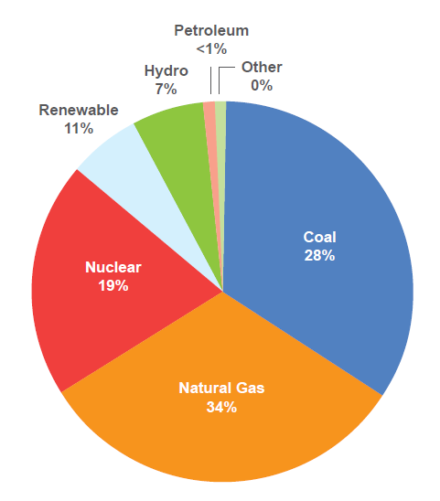
Coal-Based Power Sector Generation Share, 2018
Source: Energy Information Administration
2018 data are preliminary.
The National Mining Association | Mining 2017 Industry Overview | 22
The National Mining Association | Mining 2020 Industry Overview | 22

Slide 23
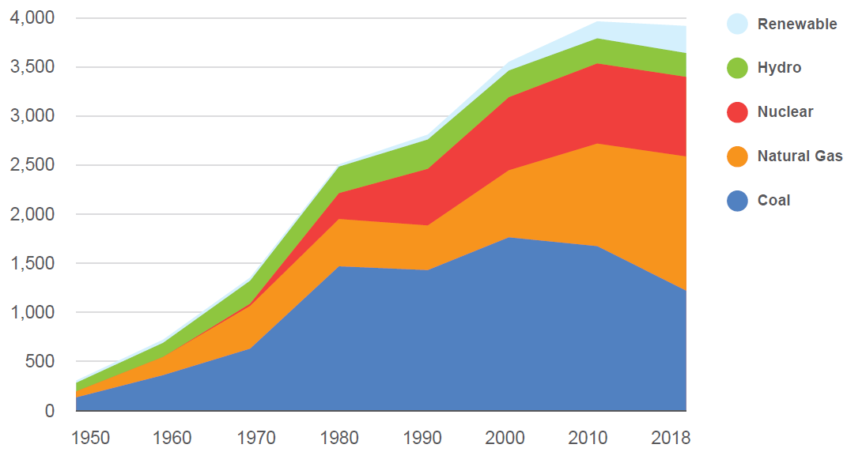
U.S. Electric Power Sector Net Generation
1950–2018 (Billion kWh)
Source:
Energy Information Administration
The National Mining Association | Mining 2017 Industry Overview | 23
The National Mining Association | Mining 2020 Industry Overview | 23

Slide 24
43%
Amount of U.S. copper demand that goes to the construction industry.¹
Foundation
of America’s Infrastructure
70%
Portion of the world’s steel produced using coal.
6 billion
Tons of steel used in the U.S. National Highway System.³
65%
Portion of global zinc consumption used to coat steel, making it highly resistant to corrosion.
439 lbs.
Amount of copper used in the average American home.
America’s miners play an indispensable role in powering and building our nation. From foundations to roofs, power plants to wind farms, roads and bridges to communications grids and data storage centers—America’s infrastructure projects begin with mining.
19%
Amount of U.S. copper used in electrical infrastructure and electronic products.⁸
90%
Amount of kyanite transformed in 2016 into mullite, an essential material for infrastructure because of its heat resistance, used in refractory and ceramic products. It is also used in many electronics – from electrical insulators to spark plugs.⁷
98%
Amount of iron ore mined in the world that is used to make steel, the foundation of the world’s tallest buildings.⁴
Notes:
¹ USGS, http://minerals.usgs.gov/minerals/pubs/commodity/copper/mcs-2019-coppe.pdf
² Empire State Realty Trust and Buildings.com, http://www.esbnyc.com/sites/default/files/esb_fact_sheet_4_9_14_4.pdf;
³ http://www.buildings.com/article-details/articleid/3180/title/the-empire-state-building-an-innovative-skyscraper.aspx
³ USGS, https://pubs.usgs.gov/fs/2006/3127/2006-3127.pdf
⁴ World Steel Association, https://www.worldsteel.org/publications/fact-sheets/content/00/text_files/file0/document/fact_raw%20materials_2014.pdf
⁵ USHistory.org, http://www.ushistory.org/libertybell/facts.html
⁶ National Park Service, https://www.nps.gov/stli/learn/historyculture/statue-statistics.htm
⁷ Minerals Make Life, https://mineralsmakelife.org/resources/minerals-rebuilding-america/
⁸ NMA, https://nma.org/2017/07/18/freeport-mcmoran-rebuilding-america-from-the-ground-up/

Slide 25
Enhancing National Security
Metals and minerals are essential elements for safeguarding our nation. Our abundant domestic supplies of metals and minerals minimize our reliance on foreign countries for these vital resources. And our Armed Forces rely on domestic metals and minerals for sophisticated weapons systems and safe transport of our troops.
750,000
Tons of minerals that are used by the U.S. Department of Defense each year in technologies that protect
our troops.¹
6.6 lbs.
Amount that lithium-ion batteries can lighten a ground troop’s pack, while providing three times the charge.
9%
Amount of U.S. beryllium production utilized in defense applications each year.
Beryllium is used to reduce weight and improve guidance performance in fighter jets and NASA technologies such as the mirrors on the James Webb Space Telescope.²
Notes:
¹ Alliance for American Manufacturing, http://docs.house.gov/meetings/FA/FA14/20130725/101216/HHRG-113-FA14-Wstate-AdamsB-20130725.pdf
² Beryllium Science & Technology Association, http://beryllium.eu/about-beryllium-and-beryllium-alloys/uses-and-applications-of-beryllium/

Slide 26
Safety
The safety and health of our workers and colleagues is a core value of the mining industry. Today’s modern mining companies recognize that continuous performance improvement necessary to achieve the goals of zero fatalities and injuries means going beyond what’s required by regulations.
To accelerate the pace of mine safety improvement, the U.S. mining industry has taken voluntary steps to implement best practices that encourage a “culture of safety.” By identifying and eliminating potential hazards, and deploying state-of-the-art technology, American mining has developed an award-wining safety framework that is bringing more miners home safely after every shift.
52%
Amount by which injury rates in U.S. mines have been reduced since 2004.
49%
Amount by which fatality rates
in U.S. mines have been
reduced since 2004.
Notes:
¹ Mine Safety & Health Administration, https://www.msha.gov/news-media/press-releases/2016/04/07/preliminary-msha-data-indicate-2015-was-safest-year-mining
² Mine Safety & Health Administration, https://www.msha.gov/data-reports/statistics
³ Mine Safety & Health Administration, https://www.msha.gov/data-reports/statistics

Slide 27
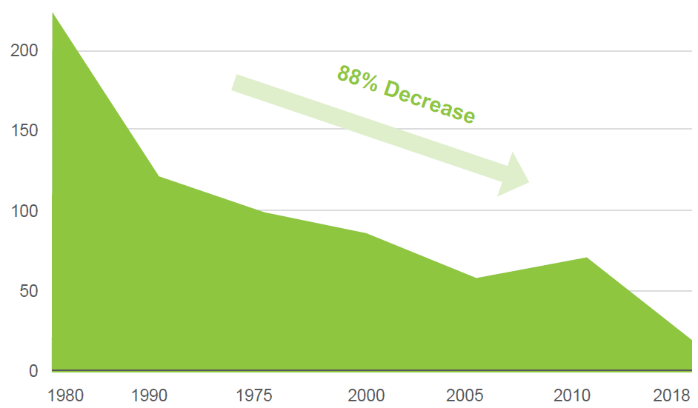
U.S. Mining Fatalities 1980–2018
Source: Mine Safety
& Health Administration
The National Mining Association | Mining 2020 Industry Overview | 27

Slide 28
Environmental Responsibility
90%
Amount by which today’s new coal-fueled power plants have reduced emissions (SO², NO_{x}, particulates and mercury), compared with the typical 1970s plants they replace.¹
Natural resources are at the heart of mining, therefore good environmental stewardship is an industry imperative and a core requirement. Mining and its employees are at the center of our communities, underscoring our commitment to being good neighbors wherever we operate.
Building on the extraordinary environmental progress made in recent decades, the industry is committed to continued technological advancements that make the use of our resources cleaner and more efficient. Even before mining begins, extensive plans are made and funding is secured to support the restoration of land after mining operations have concluded.
3 million
Number of acres of mined land that have been restored by U.S. mining companies to their natural conditions for wildlife habitats or new sites for schools, hospitals or infrastructure projects.²
$10+ billion
Amount the U.S. mining industry has paid to reclaim mines that were abandoned prior to laws requiring reclamation.³
Notes:
¹ Institute for Energy Research (NETL 2009), http://instituteforenergyresearch.org/studies/the-facts-about-air-quality-and-coal-fired-power-plants/
² Office of Surface Mining Reclamation and Enforcement, http://www.osmre.gov/resources/annualReports.shtm
³ Office of Surface Mining Reclamation and Enforcement, http://www.osmre.gov/programs.shtm

Slide 29
Challenges

Slide 30
The Affordable Clean Energy (ACE) Rule vs. The Clean Power Plan (CPP)
The ACE rule is a welcome replacement to its costly predecessor, the CPP. If allowed to go into effect, the CPP would have had a negligible impact on the environment at a great cost to average Americans who need affordable and reliable energy.
Regulating Individual Sources vs. Remaking the Entire Grid. The Clean Air Act (CAA) limits systems of emission reduction to those that can be implemented at the source, allowing EPA to regulate individual sources, not the entire electric grid, as was attempted under the CPP.
Balancing State and Federal Authority vs. A One-Size-Fits-All Mandate. EPA and the states have a shared regulatory role in emissions reduction. ACE clarifies that EPA’s role is to determine a nationally applicable system while the states determine standards and how to implement them.
Reducing Emissions without Unnecessary Costs vs. Regulating to Target an Entire Industry. ACE is expected to cut emissions by more than a third below 2005 levels by 2030 – nearly as much as CPP – while also reducing the compliance burden by up to $400 million annually when compared with the CPP.
The National Mining Association | Mining 2020 Industry Overview | 30

Slide 31
Abandoned Mined Lands
The coal industry has paid more than $9.7 billion into the AML fund to reclaim legacy abandoned mines only to see the majority of those funds disappear. Instead of focusing on how to continue to tax an industry that cannot afford it, focus and discipline should be brought to delivering the remaining AML funds to priority coal projects, as the law intended.
Just one in three dollars spent by the fund has gone to priority coal projects that the fund was intended to rehabilitate. Approximately $9 billion has been spent from the fund. But just $2.7 billion of priority abandoned coal mined lands were reclaimed as of September 30, 2018, according to the Office of Surface Mining (OSM). The $6.3 billion gap between spending and actual reclamation of priority coal AMLs reveals that just a third of funds have reached projects they were intended to remediate.
By the time the AML fee expires in 2021, the fund will have been in existence for almost 45 years—30 years beyond its intended lifespan—and will have achieved little of its intended purpose. Many of the issues surrounding the diversion and inefficient use of coal AML fees are not new; they have plagued the program for decades, and they have been examined in congressional hearings, through inspectors general reports, and by other government bodies, all with no improvement.
The National Mining Association | Mining 2020 Industry Overview | 31

Slide 32
Black Lung: Disease, regulation and research
NMA is fully committed to continuing to work to improve the health and safety of miners. Over the last two decades, effective ventilation controls, implementation of industry best practices, strict adherence to mine ventilation control plans, increased operator and miner safety awareness, and the 2014 coal dust rule, have all contributed to exponentially lower dust levels inside the mine.
While the 2014 Dust rule was specific to coal dust, there is evidence that silica dust levels have also declined in recent years. Since 2000, there has been a steady decrease in average silica concentrations detected at underground mine occupations, with the average quartz concentration between the years 2016 and 2018 measuring approximately one-fourth of the allowable MSHA exposure limit. More broadly, in 2018, 99 percent of MSHA-collected quartz samples complied with the allowable standard, a significant improvement from 2000, when 77 percent of MSHA-collected quartz samples complied.
Despite progress that has been made, we have consistently stated that more can be done. One of the challenges that we face in addressing the challenges of this disease is that symptoms do not typically present for 10 years. That means the reported increase in incidences of disease that recent studies have shown involve exposures dating back decades, before the 2014 Dust rule and stricter standards were put into place. That doesn’t mean industry is sitting idly by until the 10-year mark after the dust rule was enacted – we believe that more can be done to gain insight into and address the challenge. For instance:
  All miners should be required to participate in the National Institute for Occupational Safety and Health (NIOSH) Enhanced Surveillance Program.
  The 1/3 voluntarily participation rate does not provide a realistic appraisal of disease frequency across the entirety of the coal mining workforce.
  More importantly, failure to require participation denies the miners, their health care providers and their employers critical information necessary to implement intervention actions, if warranted, during the miners’ working career.
  The government should recognize the use of administrative controls and personal protective equipment (PPE) (such as airstream helmets) to supplement engineering controls. These are recognized industrial hygiene practices utilized in other occupational settings but, to the detriment of miner health, while some operators voluntarily provide PPEs, MSHA does not recognize their use in mining as an acceptable tool to lower exposures.
The National Mining Association | Mining 2020 Industry Overview | 32

Slide 33
Black Lung: Excise Tax
Coal companies have paid more than $22 billion into the Black Lung Disability Fund, more than covering the $17.4 billion in claims paid by the fund since 1977. This suggests a fundamental problem with the structure of the program – a program that has seen beneficiaries drop 85 percent while administrative costs per claim have climbed 1,200% over the same time period.
Increasing the burden on the coal industry isn’t the answer. NMA and its members strongly object to the recent tax increases imposed on the industry at the start of 2020, further stressing an industry that is working to stabilize after years of decline.
Industry is committed to ensuring that all miners who suffer from black lung receive the benefits they deserve, and it is already paying in many ways to ensure that happens. It's important to note that the Black Lung Disability Trust Fund only pays benefits for claims when no responsible operator can be identified. In addition to the excise tax, and separate from the fund, each operator of a coal mine is responsible for paying benefits to its miners. When a claim for benefits is approved, it is paid by the responsible operator, which is generally the last coal operator to employ the miner.
The National Mining Association | Mining 2020 Industry Overview | 33

Slide 34
Federal Coal Leasing
The U.S. Department of the Interior’s decision to lift the federal coal leasing moratorium was the right thing for the American economy, safeguarding a program that provides hundreds of millions of dollars of federal, state and local revenue per year and a valuable fuel for power generation.
Producers already pay twice. Producers currently pay in sealed bids and are subject to royalties, fees and extraction costs.
The current program benefits American taxpayers. The current federal coal leasing program pays extraordinary dividends to American taxpayers and consumers.
  $1 billion in revenues for American taxpayers.
  Taxpayers receive almost 40 cents on every dollar of coal sales.
The National Mining Association | Mining 2020 Industry Overview | 34

Slide 35
Land Withdrawal
New mining operations are already either restricted or banned on more than half of all federally-owned public lands. Given the vast amount of federal lands already closed to mining operations, caution should be exercised when determining whether additional lands should be placed off limits. In recent years, large-scale mineral withdrawals under the Federal Land Policy and Management Act have been abused in terms of need and scope.
Import dependence for key mineral commodities should be a concern to all Americans. The U.S. is import dependent for 17 key mineral resources, and more than 50 percent import dependent for an additional 29 mineral commodities – even though we have significant mineral deposits of some of these commodities within our borders.
Less than half of the mineral needs of U.S. manufacturing are met from domestically mined resources. As a result, key domestic industries are unnecessarily vulnerable to disruptions from extended, complex and fragile supply chains.
The National Mining Association | Mining 2020 Industry Overview | 35

Slide 36
Mining Law
A comprehensive network of state and federal laws govern the hardrock mining industry, making it one of the most heavily-regulated industries in the world. The General Mining Law is not an environmental statute. It is complemented by exhaustive federal and state environmental, ecological, reclamation and financial assurance laws and regulations to ensure that operations fully protect public health and safety, the environment, and wildlife.
Mining’s economic contributions to the country and to the communities in which it works are substantial. The U.S. mining industry pays between 40 to 50 percent of earnings in federal, state and local royalties, taxes, and other fees to benefit the communities in which it works and the U.S. federal government.
Punitive tax schemes that have been proposed would push the U.S. beyond the upper limit of the range in effect in other countries, significantly impairing our global competitiveness. As investments in the U.S. become less attractive, our reliance on foreign sources of minerals creates supply chain vulnerabilities for the U.S. manufacturing, energy, infrastructure, and defense industrial sectors.
Unlike other extractive industries, significant upfront exploratory and long-term project investments required to explore for, extract and refine hardrock minerals make it unlike other extractive industries. It is not unusual for a mining company to spend years exploring for mineral deposits that can be produced economically and then invest hundreds of millions or even billions on the infrastructure needed to produce those minerals. There is no market for minerals in their crude state; they require extensive and expensive refinement before they are saleable.
The National Mining Association | Mining 2020 Industry Overview | 36

Slide 37
New Source Review
New Source Review (NSR) is a flawed permitting process that deters much-needed maintenance and improvement projects at existing facilities, including projects designed to restore or improve efficiency.
NSR requires new pre-construction reviews prior to modifying existing facilities that meet certain emissions thresholds. Therefore, a project designed to improve the efficiency of a coal-fired electric generating unit by enabling it to produce more megawatts of electricity, for the same or less fuel and at a lower emission rate, could trigger NSR because the unit may increase overall emissions over the course of a year, even while it runs more efficiently per unit of fuel input.
The August 2017 U.S. Department of Energy’s “Staff Report to the Secretary on Electricity Market and Reliability” recommends that “EPA allow coal-fired power plants to improve efficiency and reliability without triggering new regulatory approvals and associated costs.”
In 2018, the EPA took concrete steps forward to improve the process, but more must be done.
The National Mining Association | Mining 2020 Industry Overview | 37

Slide 38
Permitting Delays
Minerals and metals provide key components to consumer and industrial technologies, and play a critical role in America’s national security through their use in the development and manufacture of military equipment. While the U.S. is rich in mineral resources, permitting delays and regulatory uncertainty hamper investment in our domestic resources, increasing our reliance on foreign imports.
U.S. permitting process takes close to 10 years – one of the longest permitting processes in the world. Permitting delays have been called the most significant risk to mining projects in the United States.
Despite being home to reserves estimated at $6.2 trillion, cumbersome permitting processes contribute to the U.S. importing nearly $6 billion in minerals from foreign countries each year. U.S. is import-dependent for 17 key minerals resources and more than 50 percent import-dependent for an additional 29 mineral commodities used in everyday manufacturing and defense applications.
A key national security issue, the U.S. Department of Defense uses 750,000 tons of minerals each year in technologies and equipment that protect our troops.
The National Mining Association | Mining 2020 Industry Overview | 38

Slide 39
Waters of the United States (WOTUS) Rule
The EPA and the U.S. Army Corps of Engineers wisely repealed the 2015 Waters of the United States rule, taking steps to address a deeply problematic regulation that completely ignored the balance between federal and state water regulation, and constitutional limits on federal authority.
The rule created confusion. Contrary to the stated purpose of the rulemaking, it failed to provide much needed clarity as to which waters are federally regulated. Rather than provide clear delineations between state and federal waterways, the rule provided federal regulators with expanded authority to regulate marginal waters while calling into question the status of areas never before subject to federal jurisdiction. The result: increased confusion that would have led to additional costs, delays and financial risks for nearly every sector of the economy, including the mining industry.
The rule would have hampered economic growth. By federalizing our nation’s waters and public and private lands, the rule would also have a dramatic impact on job creation and economic investment and growth. Many new projects would become cost-prohibitive, and existing lawful operations would be subjected to increased permitting requirements, delays, undue litigation threats and even potential closures.
The Clean Water Act was intended to provide both vital environmental protections for our nation’s waterways and the regulatory certainty necessary for investment and a thriving economy. The proposed rule would have muddied the application of federal regulations, putting both key interests at risk.
In 2019, the EPA and Army Corps of Engineers proposed a revised WOTUS definition that will provide long-overdue clarity regarding the scope of federal Clean Water Act jurisdiction and restore the appropriate balance between state and federal authority over waterways.
The National Mining Association | Mining 2020 Industry Overview | 39

Slide 40
Conclusion

Slide 41
Mining provides the mineral and energy resources essential for a better life and a better future.

